Slide 1
Stock Market Sentiment Analysis
By Boula Akladyous

Slide 2

Stock Market Sentiment Analysis
Project Outline
Background
Problem Statement
Business Value
Methodology
Exploratory Data Analysis
Classification and Effectiveness
Results

Slide 3
Stock Market Sentiment Analysis
Background
Stock market sentiment is a qualitative and evolving technique designed to measure the attitude and mood of investors, and how a group feels about the market economy.
there are various factors that influence market sentiment, which include news (economic, political and industry related) and social media. These factors help influence stock sentiment as they impact stock market trend.
Market sentiment can be used to determine investors’ opinions of a specific stock or asset and how optimistic people are a bout the current market conditions.

Slide 4
Stock Market Sentiment Analysis
Problem Statement
Trend Identification
Identification of trends in the stock prices of a company by performing fundamental analysis.
News Tracking
Provide real time sentiment analysis tool on tracking financial articles from different sources.
Classification Model
Classification model to gain meaningful insights on predicting either sentiment analysis and future prices.

Slide 5
Stock Market Sentiment Analysis
Methodology
Data Management
Data Scraping
Data Scrubbing
Feature Engineering
Exploratory Data Analysis
Modeling
Model Building
Model Evaluation

Slide 6
Stock Market Sentiment Analysis
Exploratory Data Analysis
Data Management
Data Scraping
Data Scrubbing
Feature Engineering
Exploratory Data Analysis
Modeling
Model Building
Model Evaluation

Slide 7
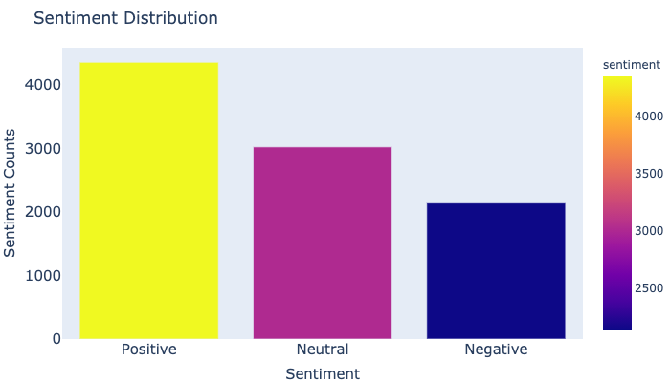
Stock Market Sentiment Analysis
Exploratory Data Analysis

Slide 8
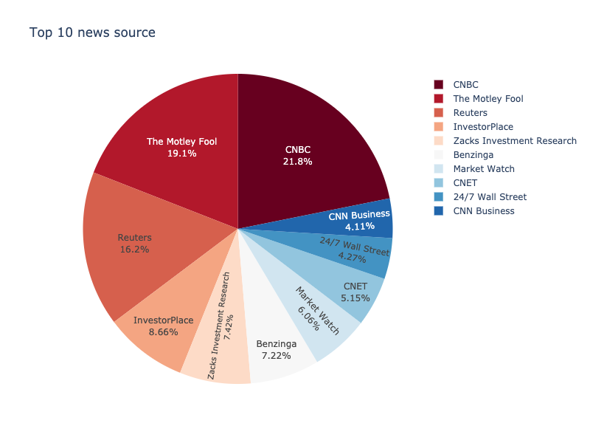
Stock Market Sentiment Analysis
Exploratory Data Analysis

Slide 9
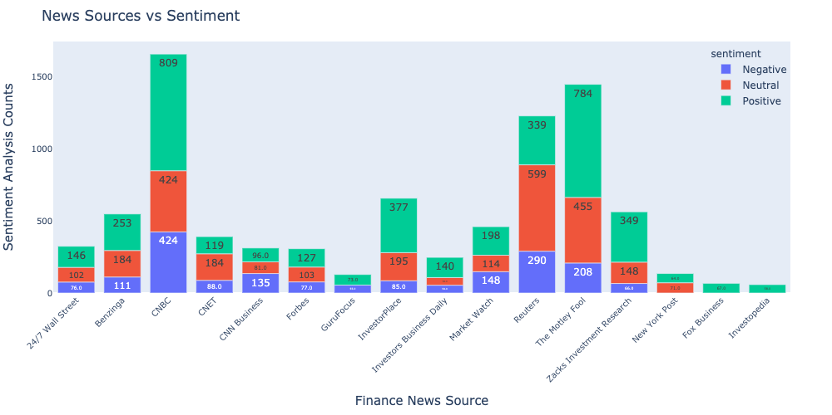
Stock Market Sentiment Analysis
Exploratory Data Analysis

Slide 10
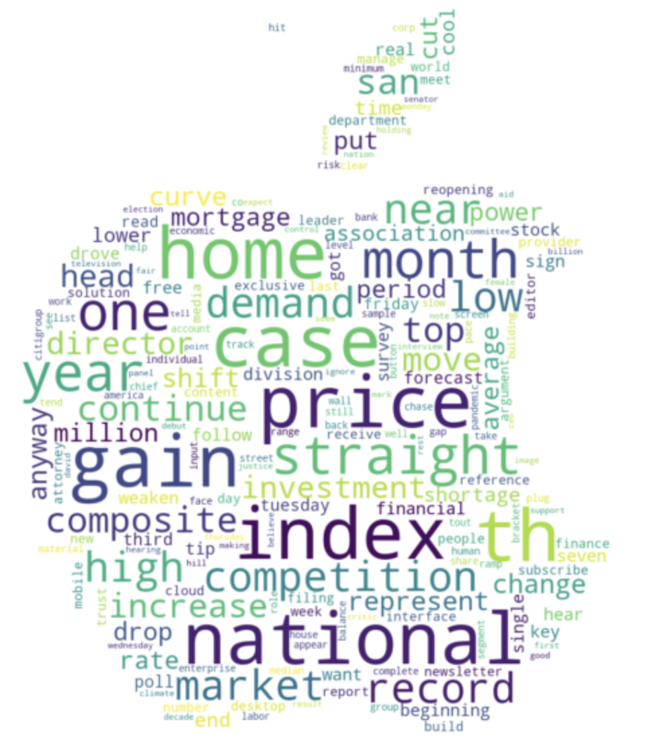
Stock Market Sentiment Analysis
Exploratory Data Analysis

Slide 11
Stock Market Sentiment Analysis
Interpretation
The method we used in our project to do sentiment analysis and price forecasting includes 2 major modeling approaches:
Sentiment Analysis Prediction
the two major methods we used to do sentiment analysis includes Recurrent Neural Network (RNN) model constructed with Embedding layer and LSTM bidirectional layer where we initialized with the embedding matrix learned from Gensim Word2Vec pretrained Model.
Stock Market Price Prediction
the second model is focused on statistical approach using SARIMAX model for a short-term time series forecasting and predicting the stock market trend.

Slide 12
Stock Market Sentiment Analysis
Conclusion
The method we used in our project to do sentiment analysis and price forecasting includes 2 major modeling approaches:
Sentiment Analysis Prediction
the two major methods we used to do sentiment analysis includes Recurrent Neural Network (RNN) model constructed with Embedding layer and LSTM bidirectional layer where we initialized with the embedding matrix learned from Gensim Word2Vec pretrained Model.
Stock Market Price Prediction
the second model is focused on statistical approach using SARIMAX model for a short-term time series forecasting and predicting the stock market trend.

Slide 13
Stock Market Sentiment Analysis
Recommendation
Since the our dataset is completely scrapped from various financial news sources, we end up with an unbalanced dataset where the positive class represent 85% of our data, however our the model did pretty good with 92.8% of Accuracy as well as and "ROC" 89% for both "True Positive Rate" & "False Positive Rate".
similarly the second dataset we used on predicting the time series and stock market price are not stationary and represent an exponential trend, however SARIMAX model are able to predict the future values of the stock price for the upcoming 6 period (30 minutes).

Slide 14
Stock Market Sentiment Analysis
Future Work
Improve web scraping technique using different API
Use SQL database to improve our model performance.
Create a real-time Dashboard for predicting market sentiment and price forecasting

Slide 15
By Boula Akladyous
Email akladyous@gmail.com
Github https://github.com/akladyous/stock-market-sentiment-analysis
Thank You

